Slide 1


Data analysis “Social Buzz”
Notes:
Hello and welcome, my name is Alejandro Thompson and today I will be presenting to you the results of the Data Analytics task.

Slide 2


Today's agenda
Project recap
Problem
The Analytics team
Process
Insights
Summary
Notes:
Today's agenda will be as follows:
1. We will recap the overall project to give a high level understanding of the business problem we're tackling and the specific requirements.
2. We will dive into the specific problem that we, the Data Analytics team, have been focusing on and will give some background as to why this is such a big problem.
3. After introducing the problem, I will go over the team responsible from our side in tackling this task.
4. I will then go over the high-level process that we followed to complete this task, so that you have complete clarity in how we tackle these kinds of tasks.
5. Finally, I will go over the all important results and I will present them as a series of insights and visualizations from our analysis.
To wrap up, I will summarize and open for any questions.

Slide 3

Social Buzz is a fast-growing technology unicorn that needs to adapt quickly to its global scale.
Accenture has begun a 3 month POC focusing on these tasks:
An Audit of Social Buzz`s big data practice
Recommendations for a successful IPO
Analysis to find Social Buzz`s top 5 most popular categories of content
Project Recap
Notes:
To begin, let me recap this engagement.
We, Accenture, have embarked on a 3-month pilot project with Social Buzz to focus on 3 main tasks, aligned with some of the biggest challenges you face today.
Social Buzz has achieved enormous scale over the past few years to become recognized as a global unicorn company. We are here to help you manage this scale and guide you in the right direction.
First, we will conduct an audit of your big data practice and share best practices and industry expertise. Second, we will guide you through a successful IPO, of which we have a wealth of experience and knowledge within our team. Finally, we have performed an analysis of your data to gain insight into the most popular categories, the most active days and times, and the most popular types of content.

Slide 4


Problem
Over 100000 posts per day
36.500.000 pieces of content per year!
Social Buzz is a media company that wants:
Merging of sample data set tables
An analysis of their content categories that highlight the top 5 categories with the largest aggregate popularity
Notes:
Focusing on the last point that I mentioned there, this is what the Data Analytics team has been specifically focused on.
Clearly with such grand scale, this comes with a lot of data and with such vast amounts of data comes challenges.
To give a background on how much data you've been creating:
- You told us that your platform receives over 100000 posts per day which amounts to 36 500 000 posts every year, of which, this is all unstructured data making it very hard to make sense of.
In this day and age, content is king. Just look at some of the biggest platforms in the world, for example YouTube, Facebook and Netflix... they are all content businesses...
But how to capitalize on it when there is so much?
It's not just all about harvesting as much content as possible... The real value is in understanding and crunching this content to gain a deeper understanding of your audience and to therefore provide a more personalized and enjoyable experience.
And this is where out data analytics expertise comes in, with the insights that we've uncovered from this task, we can show you exactly how to take analytics to production at scale.

Slide 5



Andrew Fleming
Chief Technical Architect
The Analytics team
Marcus Rompton
Senior Principle
Alejandro Thompson
Data Analyst
Notes:
Speaking of expertise, at Accenture we have a big data analytics practice, but we had a 3-person team focused primarily on this task. Andrew Fleming is our chief technical architect and his expertise really helped guide the team to produce high quality analytics.
Marcus Rompton, senior data expert, has worked with the world's largest clients in solving their data problems and was heavily involved in the data engineering part of this project.
And finally, myself, Alejandro Thompson, who was solely responsible for taking the reins of the team and delivering high quality insights from the raw data sets and turning them into business decisions.

Slide 6
1
Data Understanding
Process
2
Data Cleaning
3
Data Modeling
4
Data Analysis
5
Uncover insights
Notes:
So, how did we tackle this problem?
Well, we approached it in 5 steps:
1. Data understanding - the key to success on any data project is to understand the data in detail. So we took the time to understand the data model and domain of your business.
2. Data extraction - after understanding your business, we then architected what an ideal dataset should look like for this problem and extracted it from the relevant data sources.
3. After extracting the raw data, we needed to process and model this data into a dataset that can precisely answer the business questions and produce analytics.
4. With our new dataset, we used our analytical expertise to uncover insights from this dataset and to produce visualizations to describe the insights.
5. And finally we used these insights to unlock business decisions and to make recommendations on next steps.

Slide 7
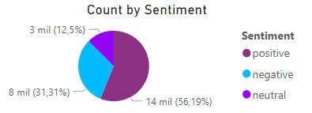
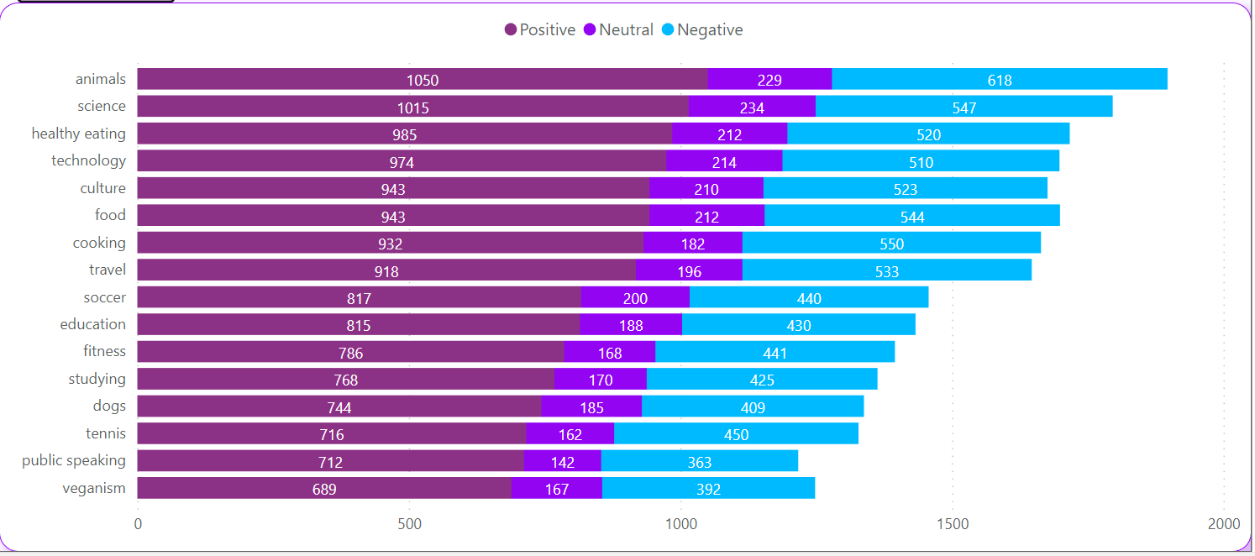

Insights
Notes:
From your data we found that you had a total of 16 unique categories of posts across your sample dataset.
Let's move on to the main question... what were the 5 most popular categories of posts?
After all this analysis we have been able to identify that the categories with the most reactions are Animals, Science, Healthy Eating, Technology and Culture. Although we can say that the Animals category has more reactions than all of them, it also leads with negative reactions. Neutral reactions have an average of 192 reactions. As we can see the percentage of positive reactions exceeds the negative ones and that is a good indicator.

Slide 8
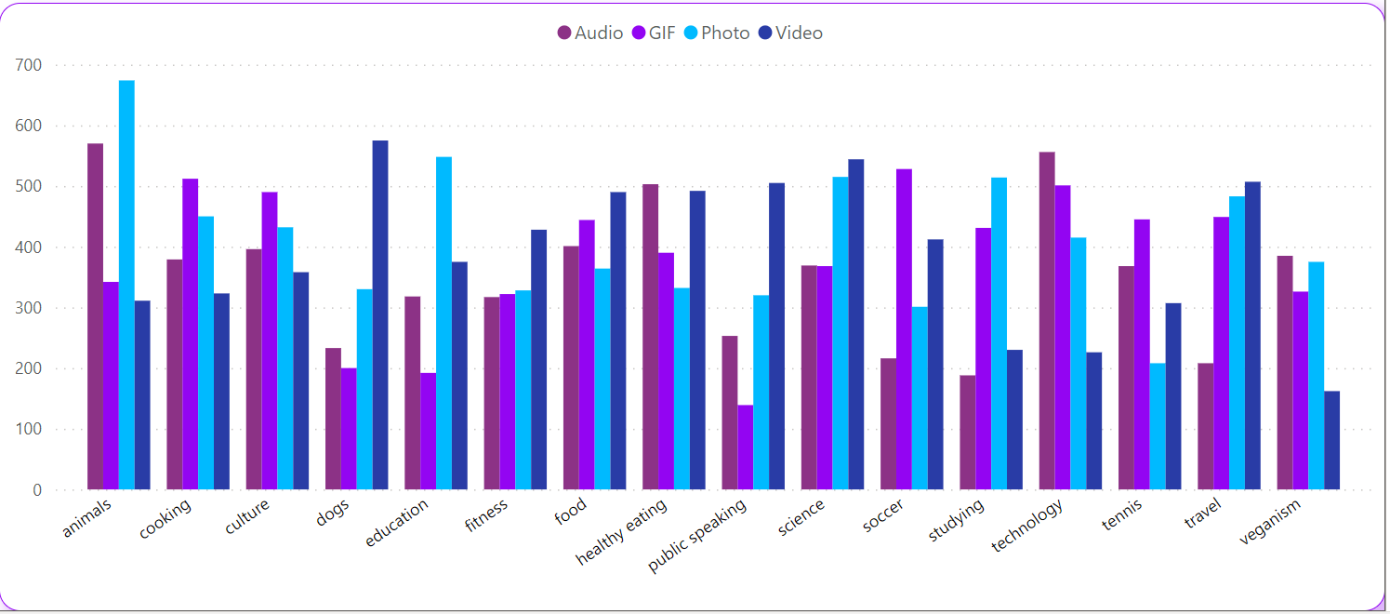
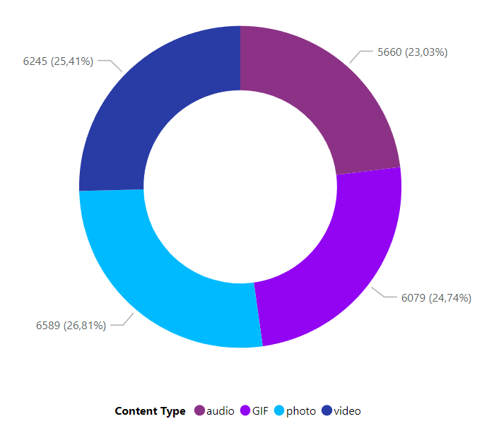
Notes:
Analyzing the types of content uploaded to the platform, we can say that there is no great difference and they are distributed with almost the same percentage.
The category that uploads the most content is animals.
More photos and audios are uploaded in the animal category, nature has become a key topic. Soccer GIFs get the most reactions. GIFs of moves, dribbles and goals are in high demand.
Dog videos are the most interacted with by users.

Slide 9
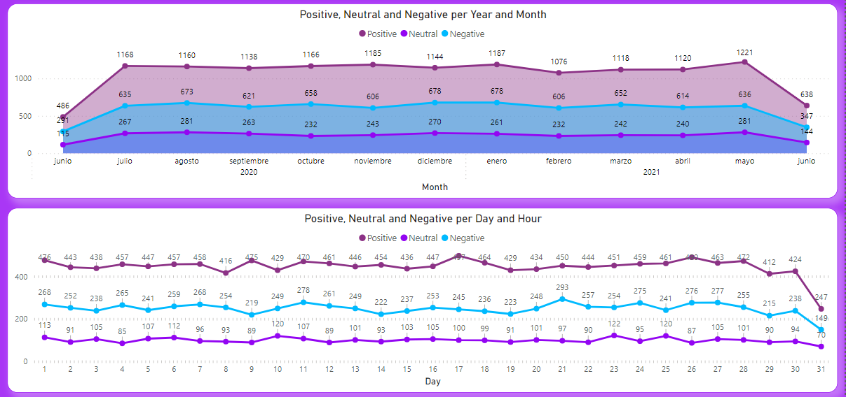
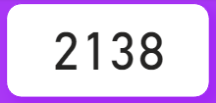
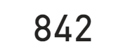
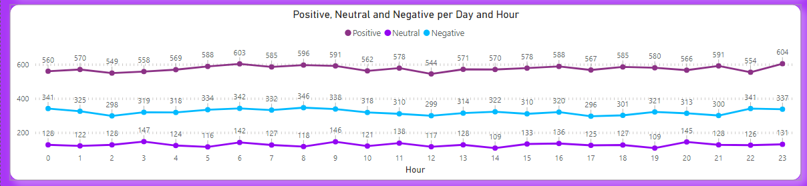
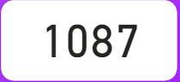
May 2021
17
6
Notes:
It's time to talk about times
We found that the most active month was May. The least active month was February.
The most active day of the month is the 17th.
According to the analysis we found that posting at 6 am will bring more reactions. The publications at 12 am and 17 pm are the ones that got less reactions, so you know what time not to publish hahaha.

Slide 10

Users like "real life" content.
The 5 categories with the most reactions are animals, science, healthy eating, technology, and culture.
The categories with fewer interactions are veganism, public speaking, and tennis.
More than 50 percent of the reactions are positive, which means that people like the content of the platform.
In terms of content type, audios are 2% less than the other categories.
Photos are the most reacted to.
In this year the reactions have been very positive, in May and January there are more reactions.
The key day is the 17th
The key time to share content is at 6 am.
Summary
Notes:
So to summarize:
- As much as this analysis was insightful, we are ready to take it to the next stage and we have the expertise within Accenture to help you realize these kinds of insights in production across your organization and in real time. We would love to help you with this.

Slide 11

Thank you!
ANY QUESTIONS?
Notes:
Thank you very much for listening, please feel free to ask any questions that you may have!

